Slide 1
Guide to Programming with Python
Chapter Four
for Loops, Strings, and Tuples: The Word Jumble Game

Slide 2
Objectives
Construct for loops to move through a sequence
Use the range() function to create a sequence of integers
Treat strings as sequences
Use tuples to harness the power of sequences
Use sequence functions and operators
Index and slice sequences
Guide to Programming with Python

Slide 3
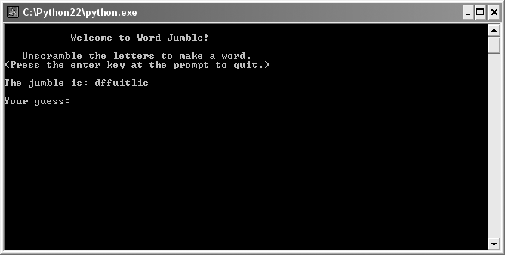
The Word Jumble Game
Figure 4.1: Sample run of the Word Jumble game
This jumble looks “difficult.”
Guide to Programming with Python

Slide 4
Using for Loops
for loop
  Like while loop, repeats a loop body
  Unlike while loop, doesn’t repeat based on condition
  Repeats loop body for each element in a sequence
  Ends when it reaches end of the sequence
  e.g., go through sequence of game titles and print each
Guide to Programming with Python

Slide 5
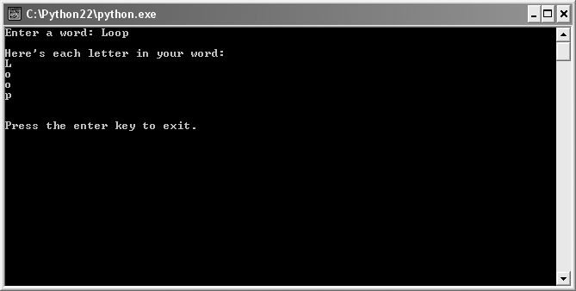
The Loopy String Program
Figure 4.2: Sample run of the Loopy String program
A for loop goes through a word, one character at a time.
Guide to Programming with Python

Slide 6
Understanding for Loops
Sequence: An ordered list of elements
Element: A single item in a sequence
Iterate: To move through a sequence, in order
List of your top-ten movies
  A sequence
  Each element is a movie title
  To iterate over would be to go through each title, in order
Element, item, or member
Guide to Programming with Python

Slide 7
Understanding for Loops (continued)
for loop iterates over a sequence; performs loop body for each element
During each iteration, loop variable gets next element
In loop body, something usually done with loop variable
Guide to Programming with Python

Slide 8
Understanding for Loops (continued)
for letter in word:
  print letter
A string is a sequence of characters
So loop iterates over string word
Loop body simply prints each element
Guide to Programming with Python

Slide 9
Counting with a for Loop
Can use for loop to count
Can use in combination with range() function
Guide to Programming with Python

Slide 10
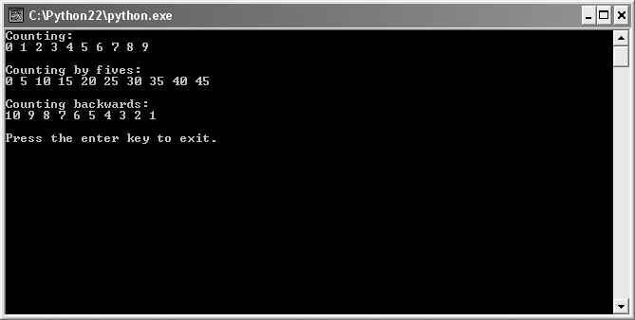
The Counter Program
Figure 4.3: Sample run of the Counter program
Using a for loop, counts forward, by fives, and backward.
Guide to Programming with Python

Slide 11
The range() Function
>>> range(5)
[0, 1, 2, 3, 4]
>>> range(0, 50, 5)
[0, 5, 10, 15, 20, 25, 30, 35, 40, 45]
Returns a sequence of integers in range
range(i) returns sequence 0 through i – 1
range(i, j) returns sequence i through j – 1
range(i, j, k) returns sequence i to j - 1, step k
Guide to Programming with Python

Slide 12
Counting Forward, By Fives, and Backwards
# counting forward
for i in range(10):
  print i,
# counting by fives
for i in range(0, 50, 5):
  print i,
# counting backwards
for i in range(10, 0, -1):
  print i,
Guide to Programming with Python

Slide 13
Using Sequence Operators and Functions with Strings
Python has functions and operators that work with sequences
Can tell you things such as
  Length of sequence
  If contains specific element
Guide to Programming with Python

Slide 14
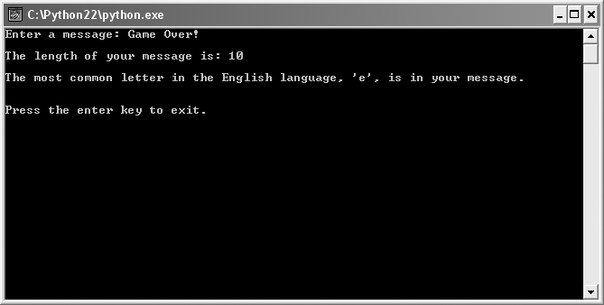
The Message Analyzer Program
Figure 4.4: Sample run of the Message Analyzer program
len() function and in operator produce information about a message.
Guide to Programming with Python

Slide 15
Using the len() function
>>> len("Game Over!")
10
Takes a sequence
Returns the number of elements
In strings, every character counts – spaces and punctuation
Guide to Programming with Python

Slide 16
Using the in Operator
>>> "e" in "Game Over"
True
Tests for element membership
  Returns True if element is in sequence
  Returns False otherwise
Guide to Programming with Python

Slide 17
Indexing Strings
Sequential access: Access in order
Random access: Direct access to any element
Indexing: Process used to access a specific element of a sequence
Member: An element of a sequence
Python allows for random access to sequences (such as strings) via indexing
Guide to Programming with Python

Slide 18
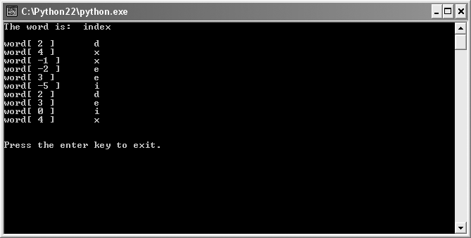
The Random Access Program
Figure 4.5: Sample run of the Random Access program
You can directly access any character in a string through indexing.
Guide to Programming with Python

Slide 19
Working with Positive Position Numbers
>>> word = "index"
>>> word[3]
'e'
Use brackets and position number to index
Indexing for positive position numbers starts at 0
Length of sequence minus one is last position
Attempt to access beyond last position results in error
Guide to Programming with Python

Slide 20
Working with Negative Position Numbers
>>> word = "index"
>>> word[-2]
'e'
Can use negative position numbers
Start at end of sequence with position number: –1
End at first element, with position number: negative sequence length
Guide to Programming with Python

Slide 21
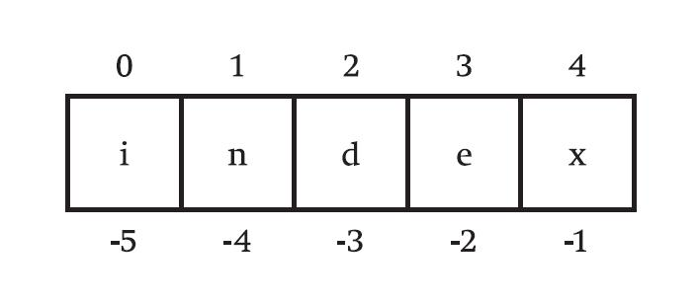
Positive and Negative Position Numbers
Figure 4.6: Sequence Indexing
Guide to Programming with Python

Slide 22
String Immutability
>>> word = "game"
>>> word[0] = "l"
TypeError: object does not support item assignment
Mutable: Changeable
Immutable: Unchangeable
Strings are immutable sequences; can’t be changed
But can create new strings from existing ones (like through concatenation)
Guide to Programming with Python

Slide 23
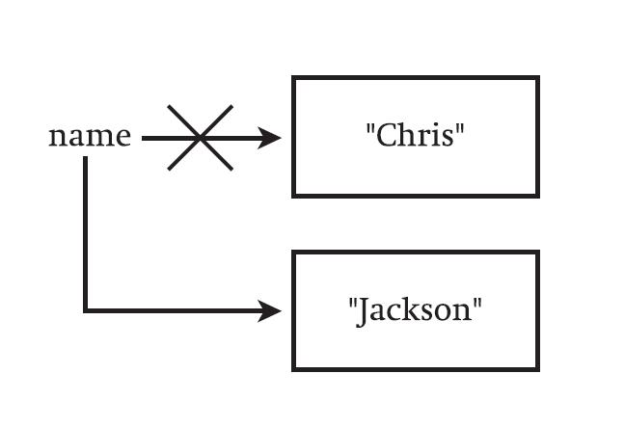
String Immutability (continued)
Figure 4.7: Demonstration of string immutability
Guide to Programming with Python

Slide 24
Building a New String
Can't modify an existing string
But can "build" (create) a new string with concatenation operator
Guide to Programming with Python

Slide 25
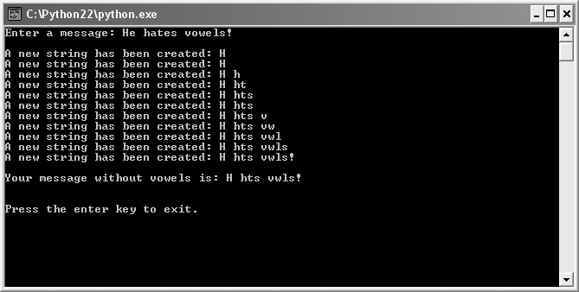
The No Vowels Program
Figure 4.8: Sample run of No Vowels program
New strings are created through concatenation.
Guide to Programming with Python

Slide 26
Constants
VOWELS = "aeiou"
Constant: Name associated with value not meant to be changed
Convention is to use all uppercase variable names
Can make programs clearer
Saves retyping (and possibly errors from typos)
No true constants in Python
Guide to Programming with Python

Slide 27
Creating New Strings from Existing Ones
new_message += letter
Concatenation creates brand-new string
Remember, strings are immutable
So, new_message becomes the newly created string resulting from concatenation
Guide to Programming with Python

Slide 28
Slicing Strings
Slice: Copy of continuous section of a sequence
Can make slices (copies) of continuous sections of sequence elements
Can slice one element or multiple, continuous part of sequence
Can even create a slice that is copy of entire sequence
Guide to Programming with Python

Slide 29
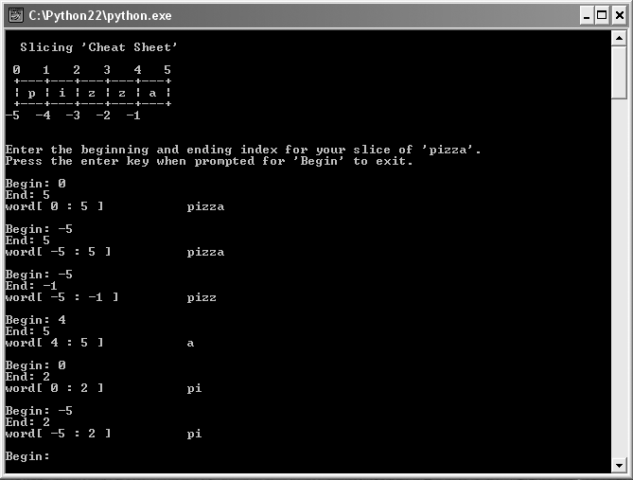
The Pizza Slicer Program
Figure 4.9: Sample run of the Pizza Slicer program
Fresh, hot slices of "pizza", made just the way you asked.
Guide to Programming with Python

Slide 30
None
Representing nothing
Makes a good placeholder for a value
Evaluates to False when treated as a condition
Guide to Programming with Python

Slide 31
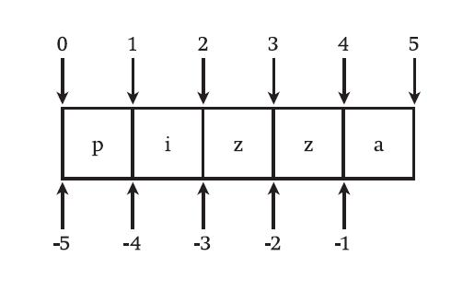
Slicing
Figure 4.10: Slicing end points
An example of slicing end point numbers for the string "pizza".
Guide to Programming with Python

Slide 32
Slicing (continued)
>>> word = "pizza"
>>> print word[0:5]
pizza
>>> print word[1:3]
iz
>>> print word[-4:3]
iz
Can give start and end position
Slice is a brand-new sequence
Guide to Programming with Python

Slide 33
Slicing (continued)
>>> word = "pizza"
>>> word[:4]
'pizz'
>>> word[2:]
'zza'
>>> word[:]
'pizza'
Can omit the beginning point
Can omit the ending point
sequence[:] is copy of sequence
Guide to Programming with Python

Slide 34
Creating Tuples
Tuple: Immutable sequence of values of any type
Could have tuple of integers for a high score list, for example
Tuples elements don't need to all be of same type
Guide to Programming with Python

Slide 35
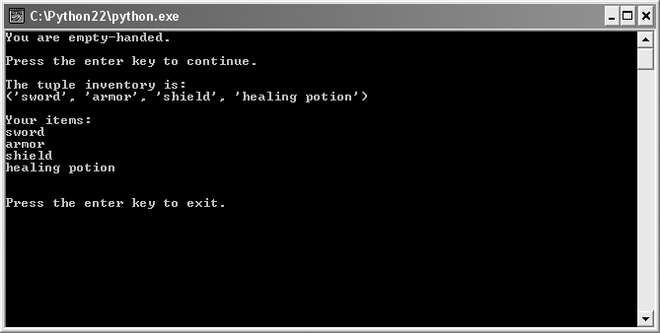
The Hero’s Inventory Program
Figure 4.11: Sample run of the Hero’s Inventory Program
The hero’s inventory is represented by a tuple of strings.
Guide to Programming with Python

Slide 36
Tuple Basics
Creating an Empty Tuple
  inventory = ()
Treating a Tuple as a Condition
  if not inventory:
    print "You are empty-handed."
Creating a Tuple with Elements
  inventory = ("sword", "armor", "shield",
  "healing potion")
Guide to Programming with Python

Slide 37
Tuple Basics (continued)
Printing a tuple
  print "\nThe tuple inventory is:\n", inventory
Looping through a tuple’s elements
  for item in inventory:
    print item
Guide to Programming with Python

Slide 38
Using Tuples
Tuples are a kind of sequence (like strings) so can:
  Get length with len()
  Iterate through elements with for loop
  Test for element membership with in
  Index, slice, and concatenate
Guide to Programming with Python

Slide 39
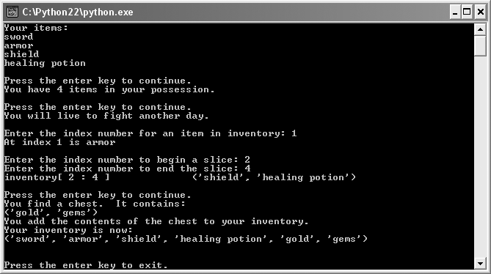
The Hero’s Inventory 2.0
Figure 4.12: Sample run of the Hero’s Inventory program
Demonstrates indexing, slicing, and concatenating tuples
Guide to Programming with Python

Slide 40
Using len() and in with Tuples
The len() function with tuples
  Just as with strings, returns number of elements
  print "You have", len(inventory), "items."
The in operator with tuples
  Just as with strings, tests for element membership
  if "healing potion" in inventory:
    print "You will live to fight another day."
Guide to Programming with Python

Slide 41
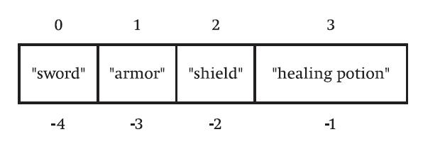
Indexing Tuples
Figure 4.13: Each element has a corresponding position number.
Each string is a single element in the tuple.
Guide to Programming with Python

Slide 42
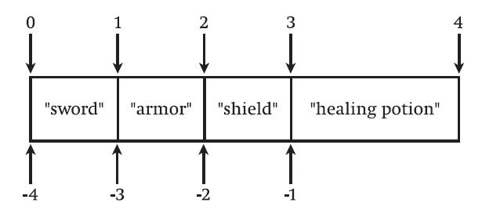
Slicing Tuples
Figure 4.14: Slicing positions defined between elements
Tuple slicing works much like string slicing.
Guide to Programming with Python

Slide 43
Tuple Immutability
>>> inventory = ("sword", "armor", "shield",
"healing potion")
>>> inventory[0] = "battleax"
TypeError: object doesn't support item assignment
Tuples are immutable
But can create new tuples from existing ones
Guide to Programming with Python

Slide 44
Concatenating Tuples
>>> inventory = ("sword", "armor", "shield",
"healing potion")
>>> chest = ("gold", "gems")
>>> inventory += chest
>>> print inventory
('sword', 'armor', 'shield', 'healing potion', 'gold', 'gems')
Concatenation operator, +, works with tuples just like with strings
Guide to Programming with Python

Slide 45
Summary
A sequence is an ordered list of elements
To iterate is to move through a sequence, in order
A for loop iterates over a sequence and performs its loop body for each element in the sequence
The range() function returns a sequence of numbers in range
The len() function returns the number of elements in a sequence
Guide to Programming with Python

Slide 46
Summary (continued)
The in operator tests for element membership and returns True if element is in a sequence and False otherwise
Indexing is the process used to access a specific element of a sequence
Mutable means changeable while immutable means unchangeable
Strings are immutable sequences
Constants are values that are not meant to change
Guide to Programming with Python

Slide 47
Summary (continued)
String concatenation creates brand-new strings
None is a value that represents nothing and evaluates to False when treated as a condition
Slicing creates a copy of a continuous segment of a sequence
A tuple is an immutable sequence of any type
The concatenation operator, +, works with tuples just like with strings
Guide to Programming with Python

